Slide 1
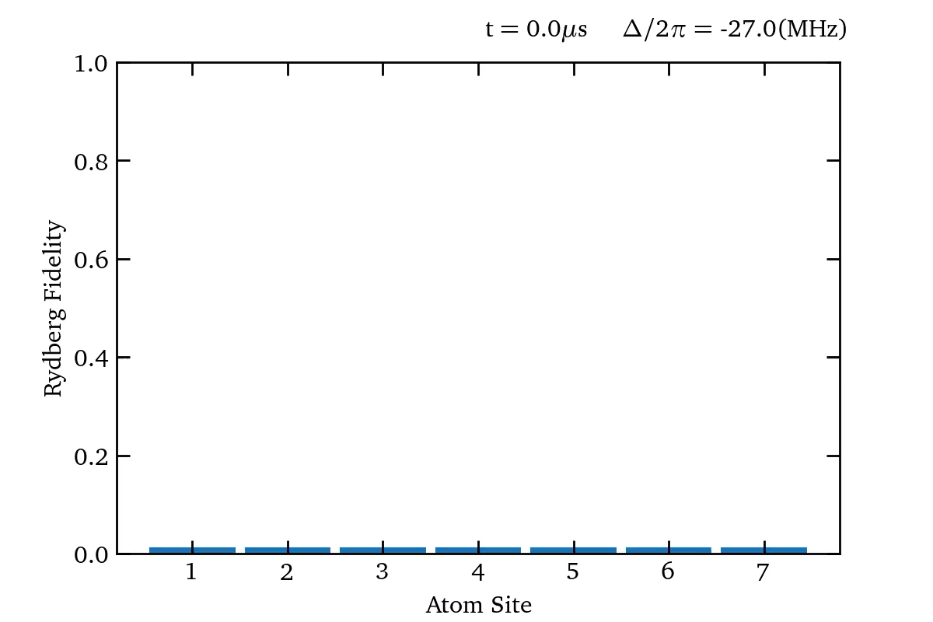
Adiabatic Sweep + Global Quench
Notes:
Simulating what is done on the Havard paper for seven atoms (order phases)
Rydberg excitations are favored but have the blocked constraint
000 to r0r0r0r
Ground state with blockade constraint
Lead by phd student only quench one atom and keep the rest at high detunning

Slide 2
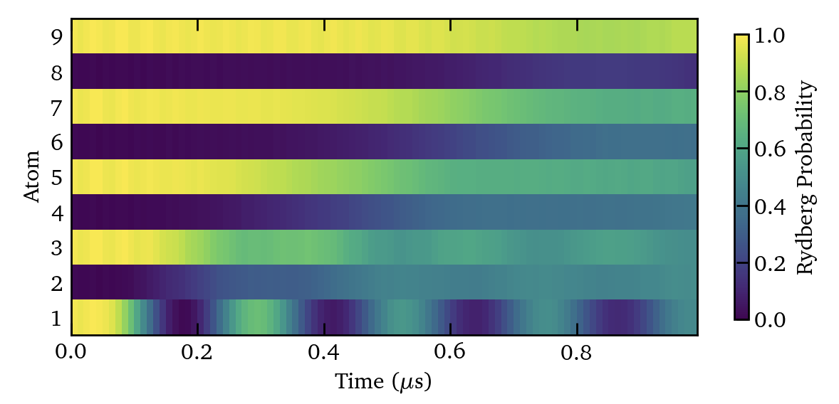
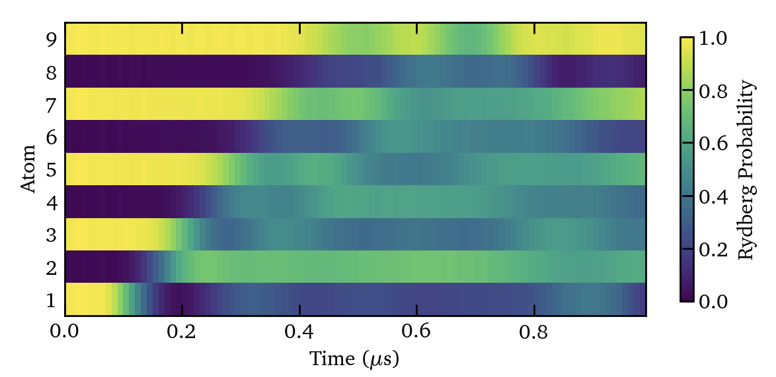
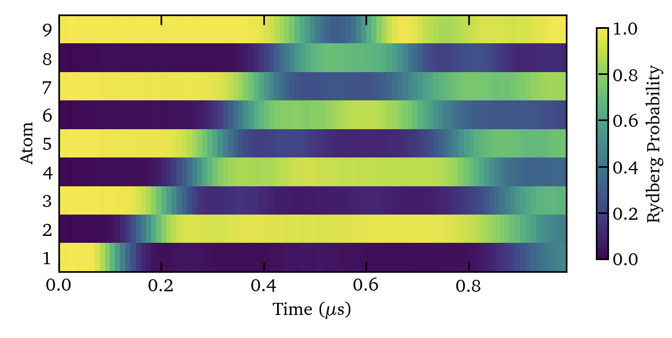
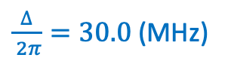

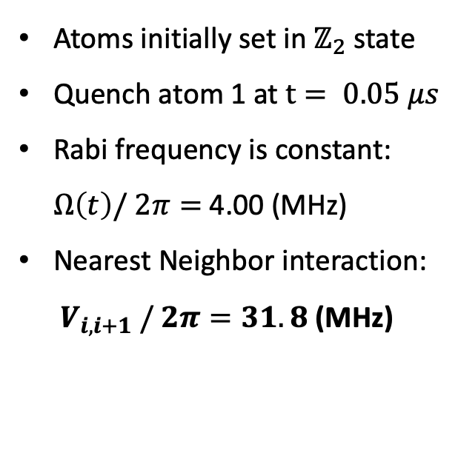
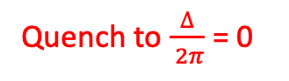
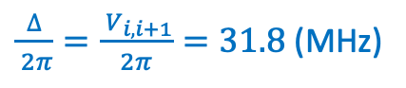
Local Quenching
Atoms initially set in $ℤ_{2}$ state
Quench atom 1 at $t= 0.05 μs$
Rabi frequency is constant: $Ω\left(t\right)/ 2π=$ 4.00 (MHz)
Nearest Neighbor interaction: ${ V}_{i, i+1} / 2π=31.8$ (MHz)
$\frac{∆}{ 2π}=24.0$(MHz)
Quench to $\frac{∆}{ 2π}$ = 0
$\frac{∆}{ 2π}=30.0$(MHz)
Atom 2-9
$\frac{∆}{ 2π}=\frac{{ V}_{i, i+1}}{2π}=31.8$(MHz)
Atom 1
Notes:
Instead of quench all of the atoms we only quench a few
In this case 1
Start in Z2 which can sweep up too
Quench from three different initial detuning regimes
How to we begin to start to understand what is on?
Rydberg fidelity picture is quite a reductive picture
Doesn’t tell us about correlations

Slide 3

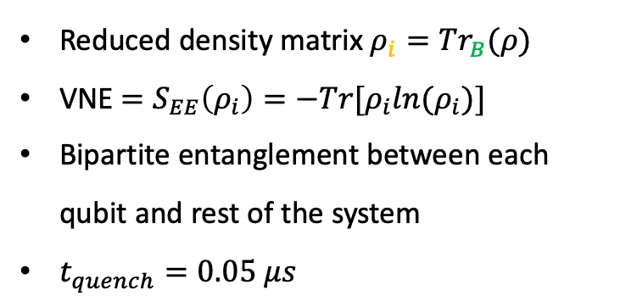
Local Quenching: Entanglement entropy
Reduced density matrix $ρ_{i}={Tr}_{B}(ρ)$
VNE $=S_{EE}\left(ρ_{i}\right)=−Tr[ρ_{i}ln{(ρ}_{i})]$
Bipartite entanglement between each qubit and rest of the system
$t_{quench}=0.05 μs$
B
i
B
Notes:
One of the things we can look at is EE
Speficialy the entanglement entropyof one qubit with compare to the rest
How much of the information about one qubit is spread across the rest
Do this

Slide 4
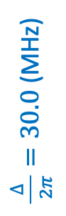
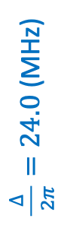
Local Quenching: Entanglement entropy
Reduced density matrix $ρ_{i}={Tr}_{B}(ρ)$
VNE $=S_{EE}\left(ρ_{i}\right)=−Tr[ρ_{i}ln{(ρ}_{i})]$
Bipartite entanglement between each qubit and rest of the system
$t_{quench}=0.05 μs$
$\frac{∆}{ 2π}=24.0$(MHz)
B
i
B
Local Quench Atom 1
No Quench
$\frac{∆}{ 2π}=30.0$(MHz)
Notes:
How entangled is atom I with the rest of the system
How much information is spread across the rest of the system
Plot this for each qubit to see how entanglement spreads across the system
Compare with no quench get rid of background
See when this entanglement impulse from the quench site arrives
With the idea of pairs in mind we consider a new entanglment monotone
Red marker indicates a clear spreation between quench and no quench case
Notice key difference between 30 and 24
Linear propagation
Coming in pairs
Pairs introduce a new entanglement monotone

Slide 5
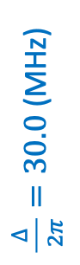
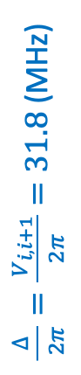
Local Quenching: Entanglement entropy
$\frac{∆}{ 2π}=30.0$(MHz)
Local Quench Atom 1
No Quench
$\frac{∆}{ 2π}=\frac{{ V}_{i, i+1}}{2π}=31.8$(MHz)
Notes:
Coming in pairs
Reduce to pair von nuemann entropy doesn’t work
Pairs introduce a new entanglement monotone

Slide 6
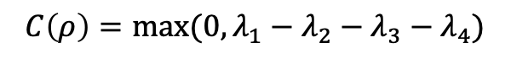
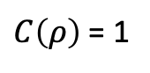
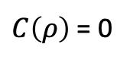
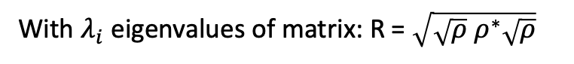

Local Quenching: Concurrence
Entanglement monotone for quantifying entanglement for both pure and mixed state of two qubits
$$C\left(ρ\right)=max⁡(0, λ_{1}−λ_{2}−λ_{3}−λ_{4})$$
$ρ= ρ_{i, j}$ 4x4 reduced density matrix of pairs of qubits
With $λ_{i}$ eigenvalues of matrix: R = $\sqrt{\sqrt{ρ}{ ρ}^{∗}\sqrt{ρ}}$
$C\left(ρ\right)$ = 1
Maximumly entangled Bell state
$C\left(ρ\right)$ = 0
Separable state
Key Idea: Pairwise entanglement between two qubits
Hill, S., & Wootters, W. K. (1997). Entanglement of a Pair of Quantum Bits. arXiv:quant-ph/9703041
Notes:
Concocurrence
Allows us to quantiry entanglement between two pair of qubits even for mixed states
0 seperable state
1 entangled state

Slide 7
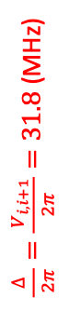
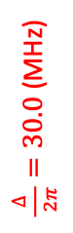
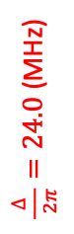
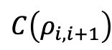
Local Quenching:
Concurrence
$\frac{∆}{ 2π}=24.0$(MHz)
Entanglement monotone for quantifying entanglement for a mixed state of two qubits
$\frac{∆}{ 2π}=30.0$(MHz)
$$C\left(ρ_{i, i+1}\right)$$
$\frac{∆}{ 2π}=\frac{{ V}_{i, i+1}}{2π}=31.8$(MHz)
Notes:
Calculate concurrence for nearest neighbor pairs in the system
24 case, as we saw with the entanglement entrproy strong pairwise correlations
Dimer link behaviour
30 case this breaks down
Interaction point get quasiparticle jet like behaviour

Slide 8
Acknowledgements
Supervisor: Prof Stuart Adams
PHD Student: Toonyawat Angkhanawin

Slide 9
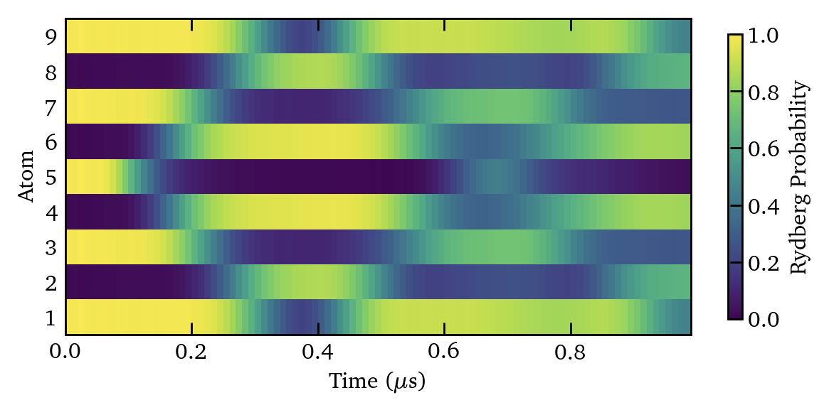
Other Local Quenches
Quench

Slide 10
Eigenenergy spectrum

Slide 11
